Slide 2
HOPE

Slide 3
Our Vision
Vision Statement
“Life in all its fullness” (John 10:10)
Our vision is to ensure that our school family are happy and fulfilled in a creative learning environment. This is flexible and caters to individual needs while developing a life-long love for learning through which all members can flourish. We nurture an aspirational family of hard-working, respectful individuals who work collaboratively.
love for learning
creative
flourish
nurture
respectful
collaboratively

Slide 4
A reminder that
all parts of our Service are invitational –
please simply be respectful
and
mindful of the
participation of others.

Slide 5
I bear witness that Muhammad is the messenger of Allah
Peace be upon him

Slide 6
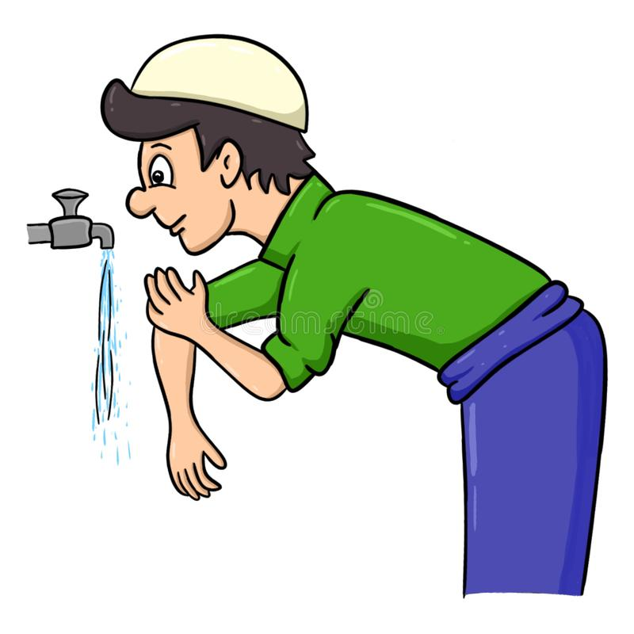
It is important that you wash your hands before this collective worship.

Slide 7
ALL DIFFERENT
ALL EQUAL
?
?
In our school family, we are all equal.
How are we all different?

Slide 8
Many children and adults in our school family follow Islam. Today we are going learn about a story from Hadith.
Hadith is the collected traditions of the Prophet Muhammad. Muslims know the Prophet as the ‘Mercy to Mankind’. We can all observe his life and learn valuable lessons, no matter which faith we follow.

Slide 9
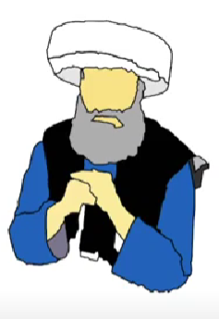
Islam teaches love, kindness, peace and respect.
What do you notice about these values?
Prophet Muhammad treated everyone with love, regardless of their age, gender, religion, or appearance.

Slide 10
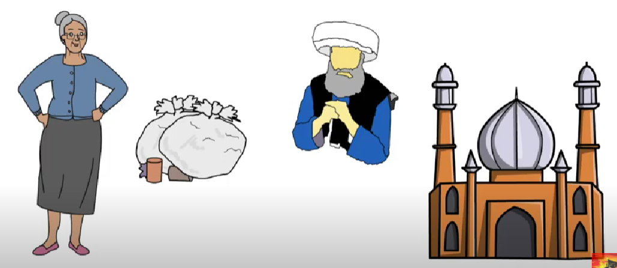
The Prophet often walked past a house, whilst walking his daily route to Mosque. A lady threw rubbish at the Prophet or in his way, whenever he walked past her house.
How would this make you feel? What would you do?

Slide 11
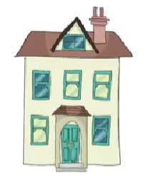
The Prophet remains patient and does not respond with anger, in words or actions. The lady continued to throw rubbish at him whilst on his daily route. One day, the Prophet walks past her house as normal, but this time, nothing happens.
How would you feel now and what would
you do?
Instead of being relieved and continuing on his journey, the Prophet asks someone nearby where the lady was. The Prophet was worried and soon learned that the lady was sick and was resting at home. He went to visit this lady, asked her how she was doing and offered to help her around the house to make life easier for her during the sickness.
The lady was moved by the Prophet’s kindness and love. With the Prophet’s support, the lady recovered. She found HOPE in Islam and became a Muslim.

Slide 12
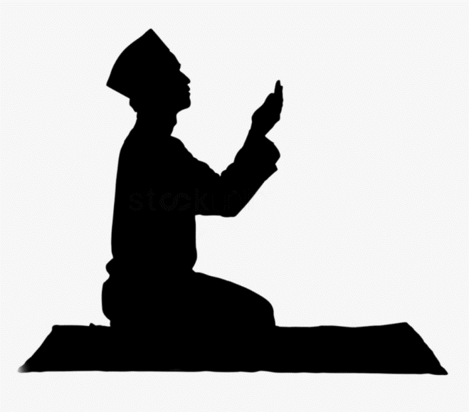
Once again, you may hold your hands, palms up or simply reflect respectfully and quietly.
Dear Allah,
We pray that you help us to find hope in faith and people, even when their actions are not kind. We pray that you help us to be kind always and hope for a better world. Inn sha allah
Ameen

Slide 13
Join in should you wish:
Peace be with you.
And also with you.
Go in peace. Go in kindness. Go in love.

Slide 14
Minute of Mindfulness
Sitting in a comfortable cross-legged position, start by cupping your hands round your mouth. Take a deep breath in through your nose and slowly start to blow out through your mouth, growing your hands outwards in time with your exhale as if you are blowing up an enormous hot air balloon. Once your balloon is as big as it can be (and you’ve finished your exhale), breath normally as you sway gently from side to side admiring your big beautiful hot air balloon as it soars through the sky.

Slide 15
WW

