Slide 1
KS1 Maths Workshop
Welcome ☺

Slide 2
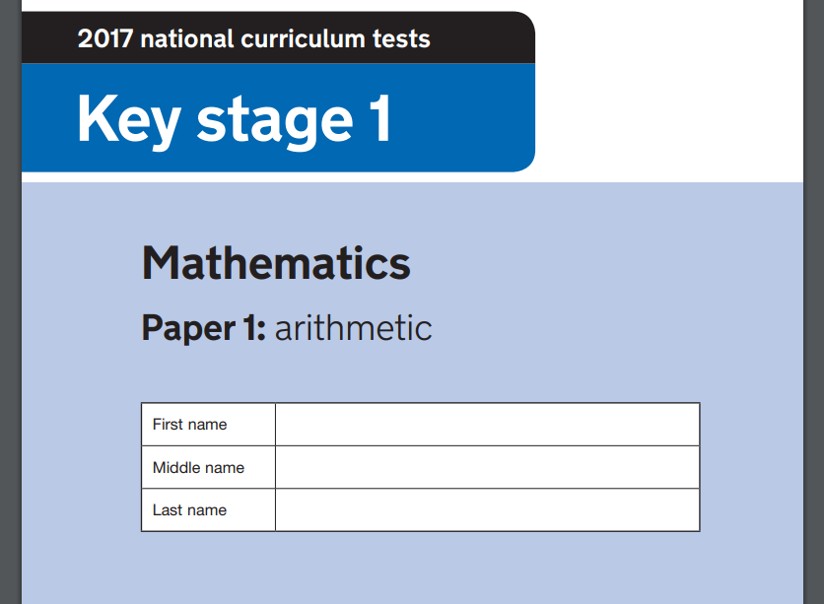
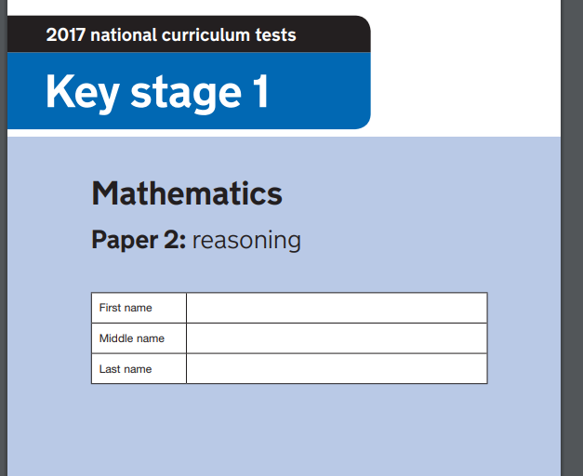
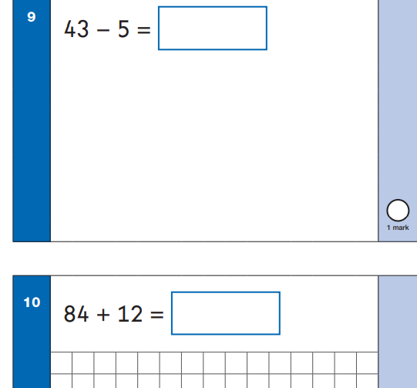
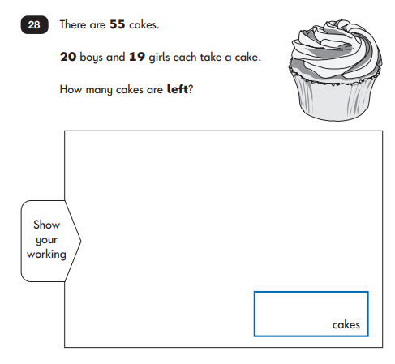

Slide 3
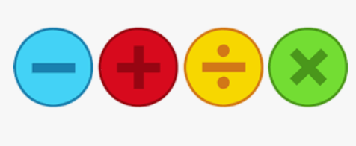

Slide 4
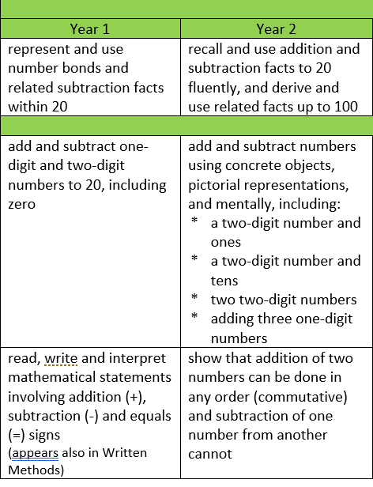
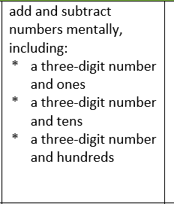
Addition and Subtraction
Year 3

Slide 5
Addition
Year 3
Year 1

Slide 6
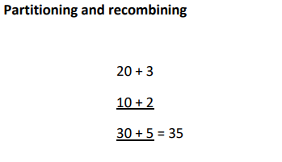
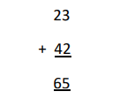
Addition +
Methods- Year 2:
Tens and ones
Tens and ones grid
Expanded column addition
Column addition

Slide 7
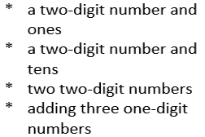
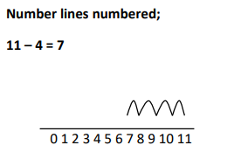
Subtraction -
Methods- Year 2:
Tens and ones
Tens and ones grid
Expanded column subtraction
Column subtraction

Slide 8
Missing number problems

Slide 9
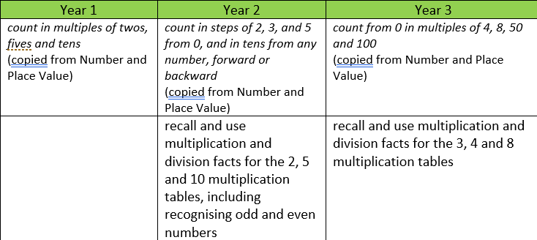
Multiplication x

Slide 10
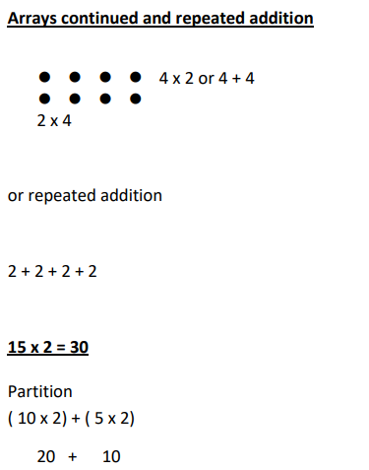
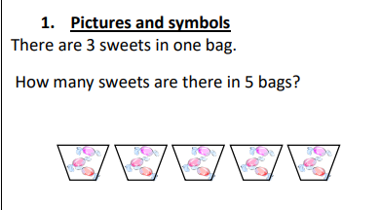
Multiplication x

Slide 11
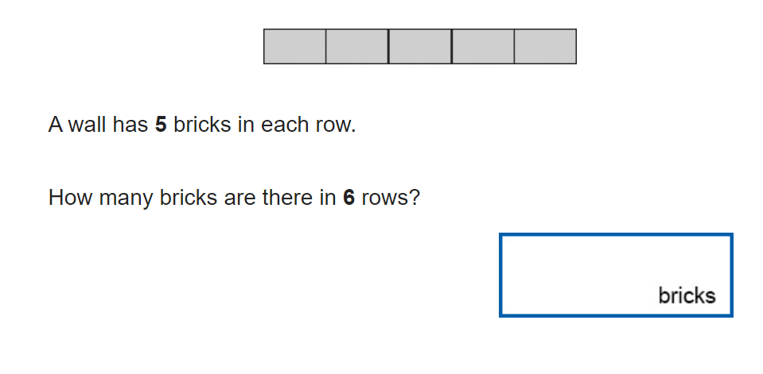

Slide 12
Division ÷
Pictures
Circles
12 ÷ 3 =

Slide 13
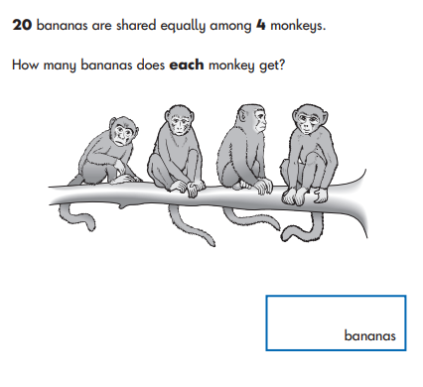

Slide 14
Quick recall

