Slide 2
Forgiveness

Slide 3
A reminder that
all parts of our Service are invitational –
please simply be respectful
and
mindful of the
participation of others.

Slide 4
This is the day that the Lord has made.
Let us rejoice and be glad in it.

Slide 5
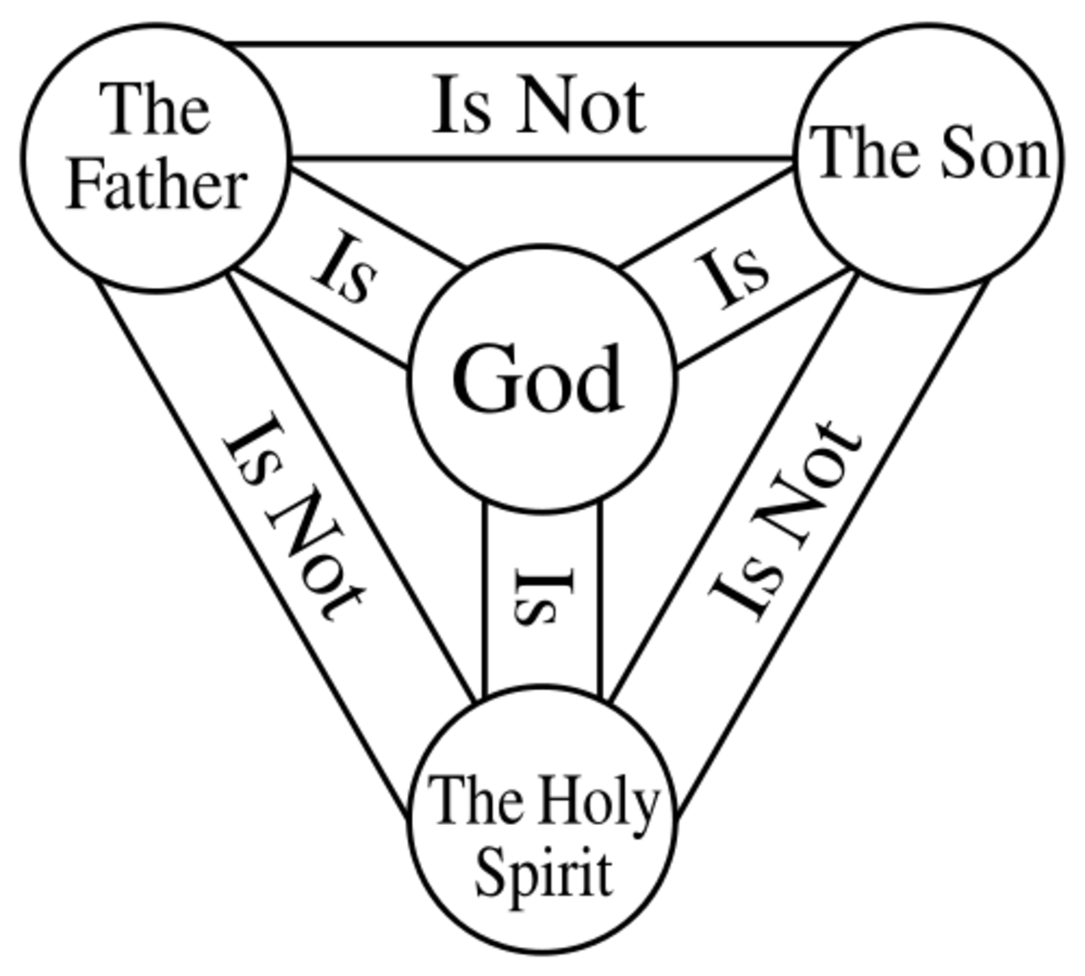
What do the three candles represent?

Slide 7
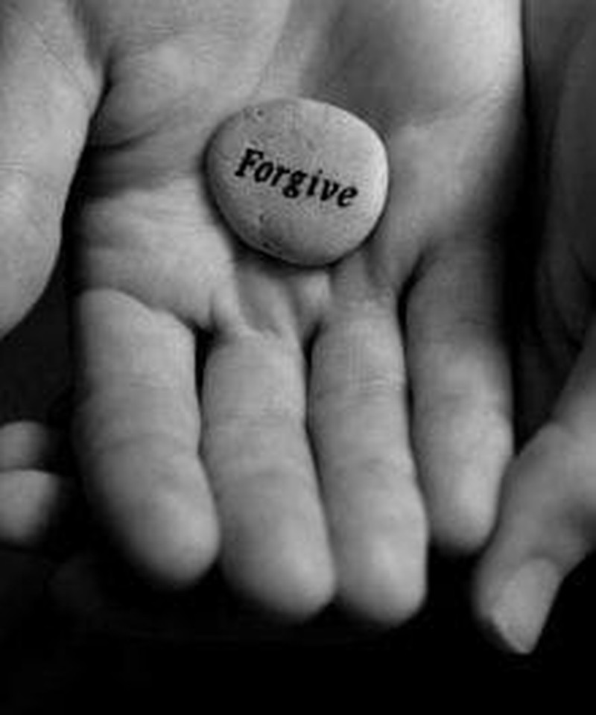
Is it difficult to forgive?
Have you ever shown forgiveness?
Why is it important to forgive someone?

Slide 8
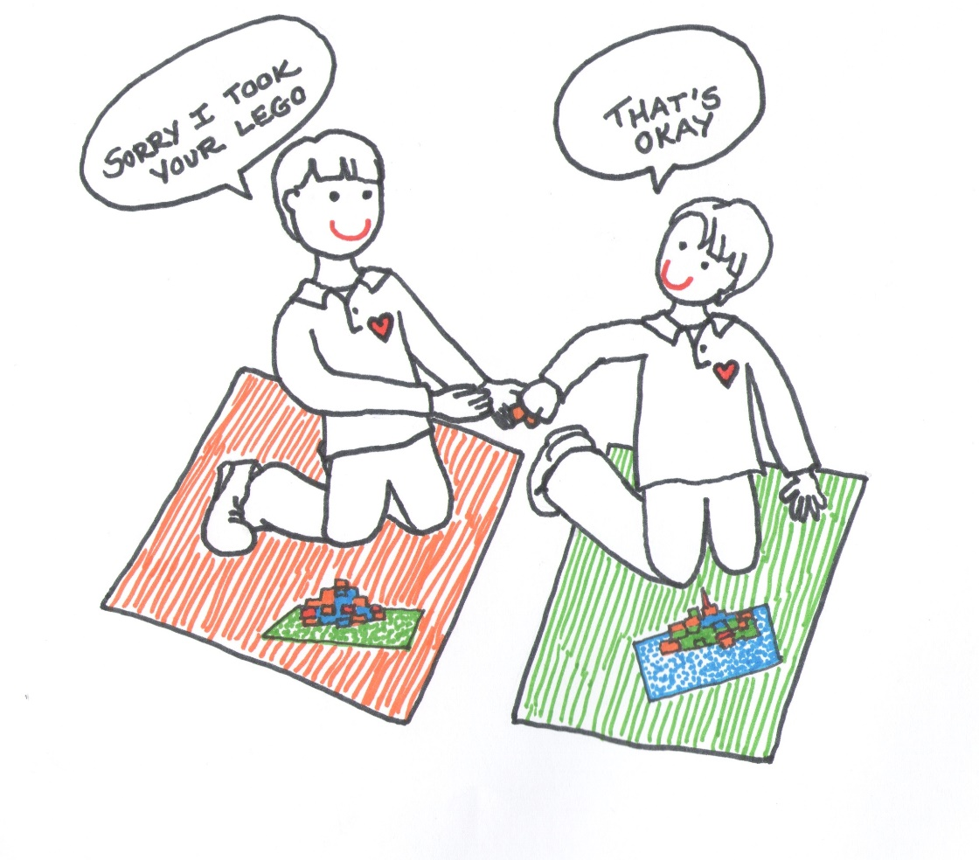
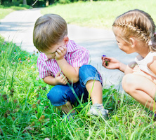
Can you think of 5 ways to show forgiveness?

Slide 9
Did you think of any of these?
Smile
Hug
Don’t remind them
Don’t gossip
Show gratitude and be thankful
Give a gift
Help out
Text message or a handwritten note
Email
Help out

Slide 10
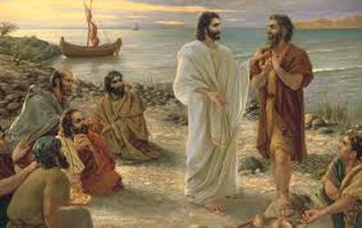
https://www.youtube.com/watch?v=ulRPKXet8n4
Notes:
In the Bible, there was one person who taught us how to forgive others.
Who do you think it is?

Slide 11
Reflection
Jesus showed us that forgiveness is not a feeling, but a decision that we make.
Can you challenge yourself to forgive even when it is tough?
Notes:
Peter denied Jesus three times, so in his love, Jesus offered Peter an opportunity to tell Jesus that he loved him—three times. And with that Peter was forgiven and made new.

Slide 12
Walk to School Week

Slide 13
Walk to School Week
Our five-day walking challenge is a celebration of the walk to school and the perfect activity to run as part of National Walking Month this May.
This fun and engaging week-long activity for primary schools has been built to make pupils experience first-hand the importance of walking to school.

Slide 14
15/05 – We walk for inclusion 16/05 – We walk for sustainability 17/05 – We walk for health 18/05 – We walk for mindfulness 19/05 – We walk for friendship

Slide 15
Walk to school icons will be given to your class teacher for you to put against your name on the good to be green chart when you arrive at school.

Slide 16
Once again, you may put you hands together, bow your heads or simply reflect quietly,
Let us pray – please select a spontaneous person to do this
Amen

Slide 17
Join in should you wish:
Peace be with you.
And also with you.
Go in peace. Go in kindness. Go in love.

Slide 18
Remember – Wycliffe walking at all times in school!
WW

