Slide 1

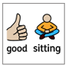

Slide 2



Courage

Slide 3
A reminder that
all parts of our Service are invitational –
please simply be respectful
and
mindful of the
participation of others.

Slide 4
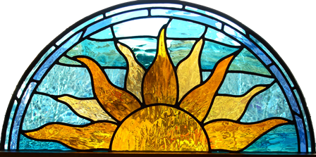
This is the day that the Lord has made.
Let us rejoice and be glad in it.

Slide 5
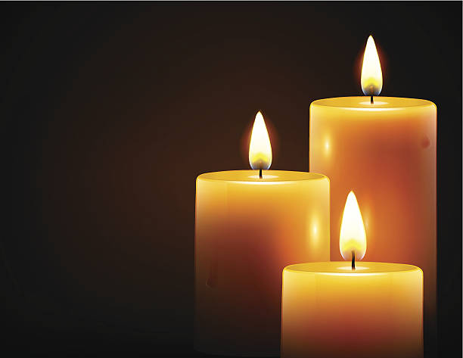
What do the three candles represent?

Slide 6




Slide 7
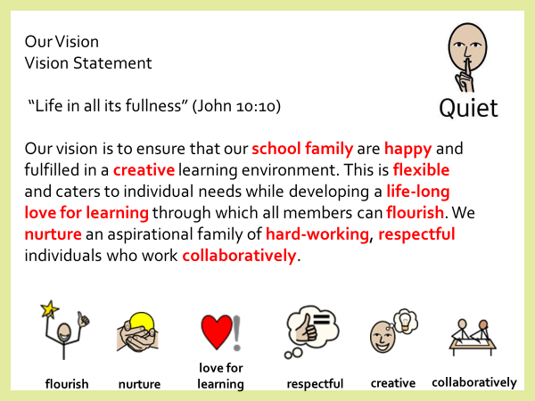

Slide 8

Courage to face your fears!

Slide 9
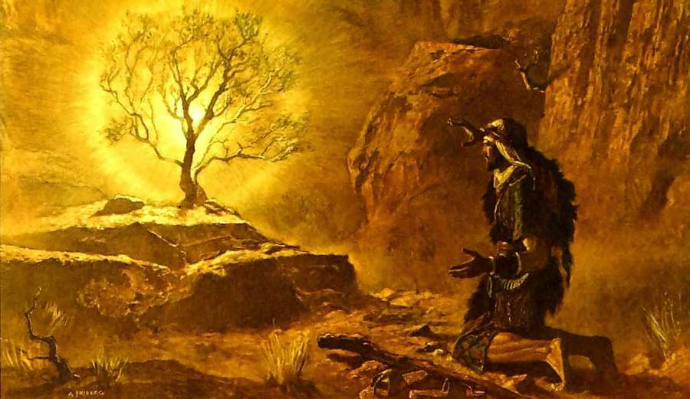

Slide 10
Would you like to be apart of the collective worship council?

Slide 11
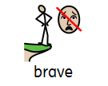







Slide 12
Would you like to be apart of the collective worship council?

Slide 13
Once again, you may put you hands together, bow your heads or simply reflect quietly,
Let us pray –
Courage
Facing fears
Amen

Slide 14
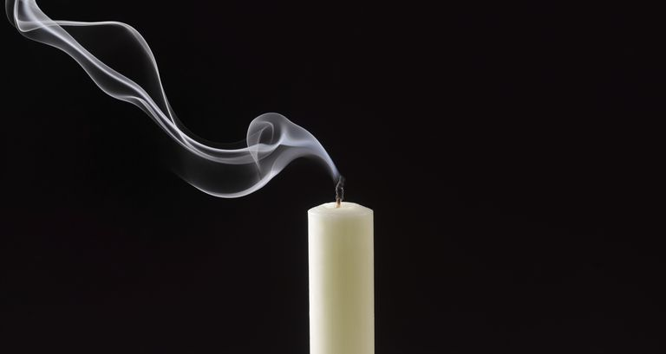
Join in should you wish:
Peace be with you.
And also with you.
Go in peace. Go in kindness. Go in love.

Slide 15
Remember – Wycliffe walking at all times in school!
WW

