Slide 1

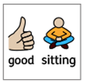
https://www.youtube.com/watch?v=0ntRQHOMt2U

Slide 2
Spontaneous Prayer
At the end of today’s Collective Worship we would like someone to come up with a prayer.
You have the whole Collective Worship to be thinking about this and there will be some key words to help you out.
Please remember that your prayer should relate to the Collective Worship and the message that we are sharing.

Slide 3


Respect

Slide 4






Our Vision
Vision Statement
“Life in all its fullness” (John 10:10)
Our vision is to ensure that our school family are happy and fulfilled in a creative learning environment. This is flexible and caters to individual needs while developing a life-long love for learning through which all members can flourish. We nurture an aspirational family of hard-working, respectful individuals who work collaboratively.
love for learning
flourish
nurture
respectful
creative
collaboratively
Notes:
Jay – This is our school vision

Slide 5
A reminder that
all parts of our Service are invitational –
please simply be respectful
and
mindful of the
participation of others.

Slide 6
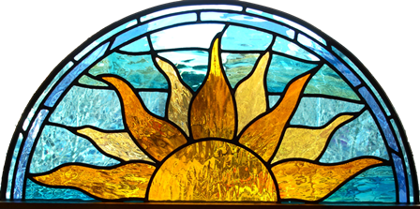
This is the day that the Lord has made.
Let us rejoice and be glad in it.

Slide 7
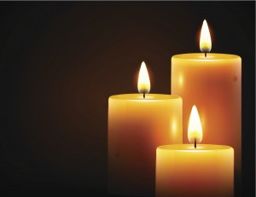
What do the three candles represent?

Slide 8
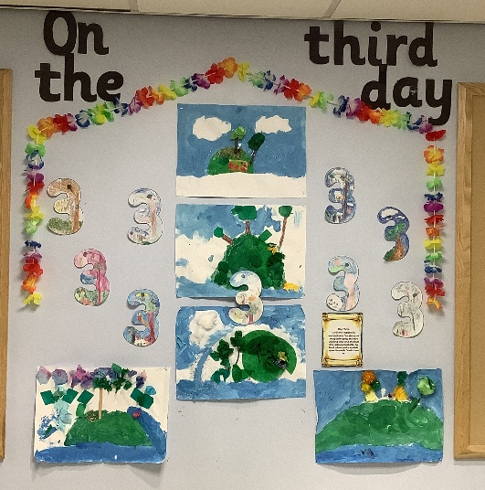
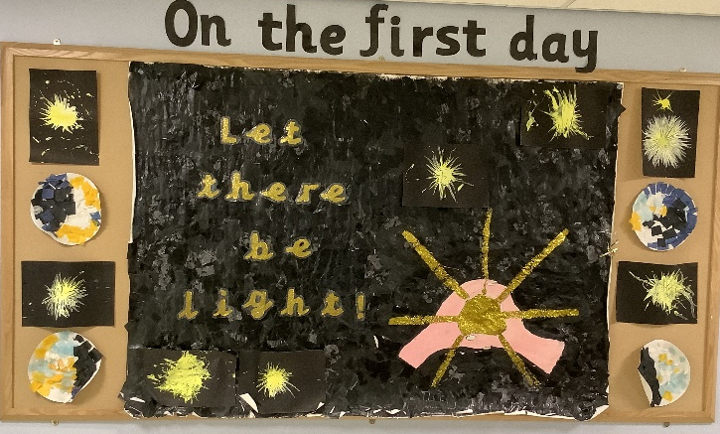
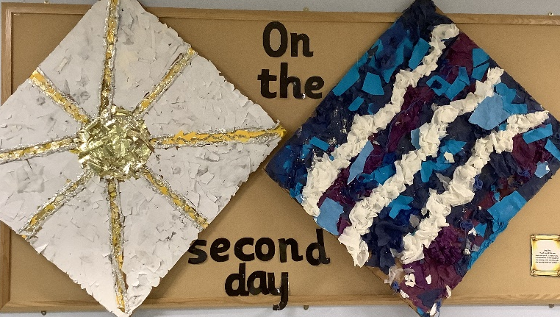
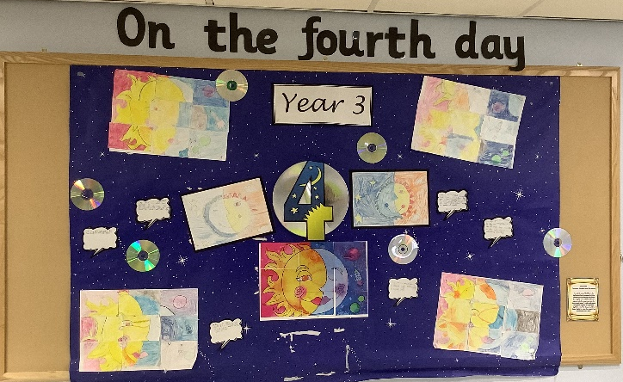
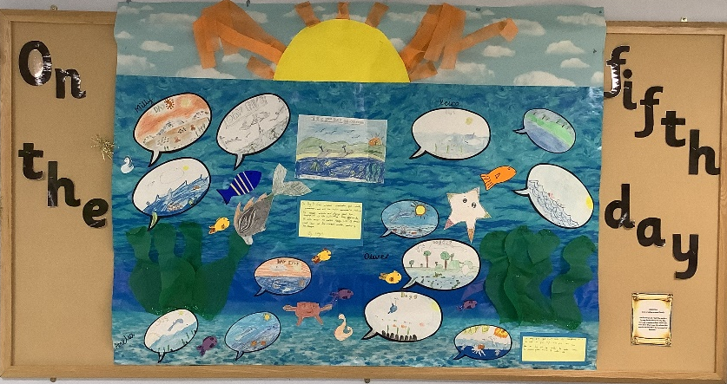
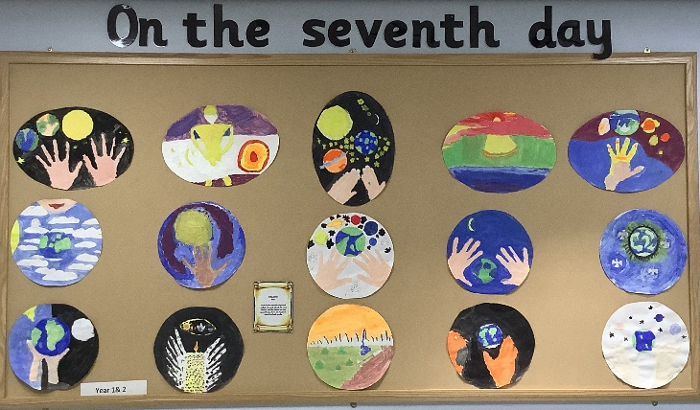
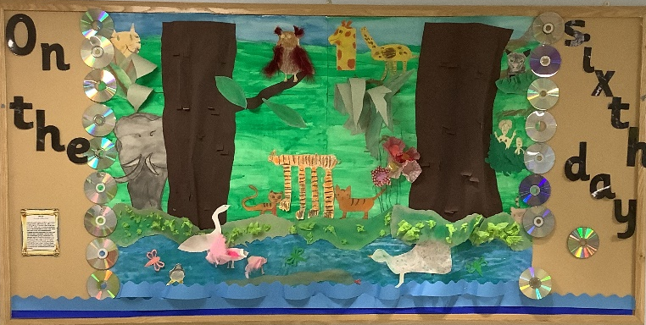
Notes:
Ben – Look at the pictures we are holding up. Do you recognise them?
Ben – These pictures represent the creation story, and you can see them on display in the dining hall.

Slide 9

Notes:
Grace - Genesis is the first book of the Bible and is where we will find all about when God created everything (Genesis 1-2). The Bible has two parts: Old & New Testament. The very first thing we learn is in Genesis 1:1. In the beginning, God created the heavens and the earth.

Slide 10

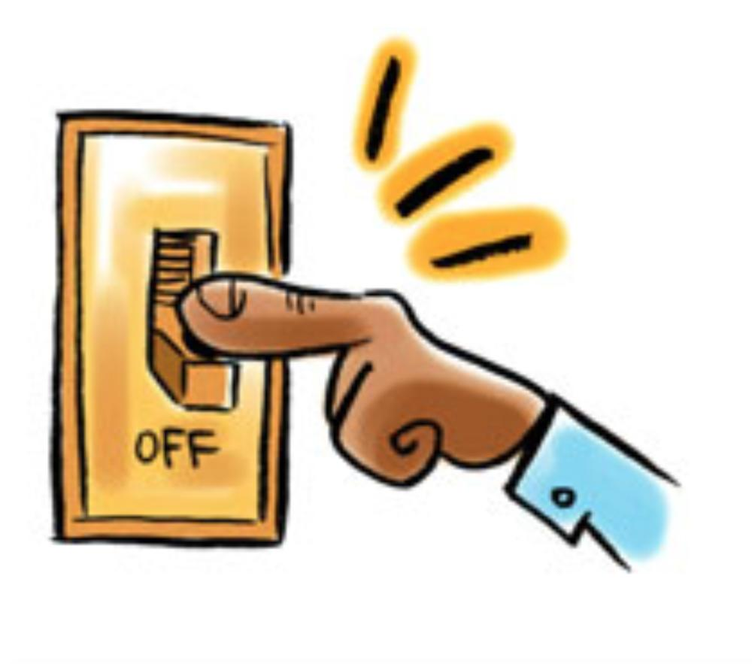

Time to reflect
How can we respect Gods world?
Notes:
Finley - God asked the first people on Earth to look after the Earth and respect it. Who can think of some ways that we can respect the place where we live?
Ask the audience
- don't drop litter,
- turn off lights to save energy
- recycle)

Slide 11
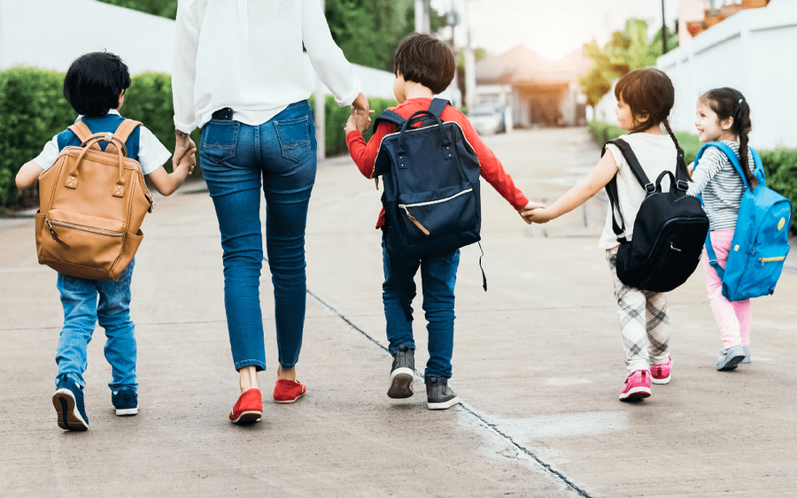
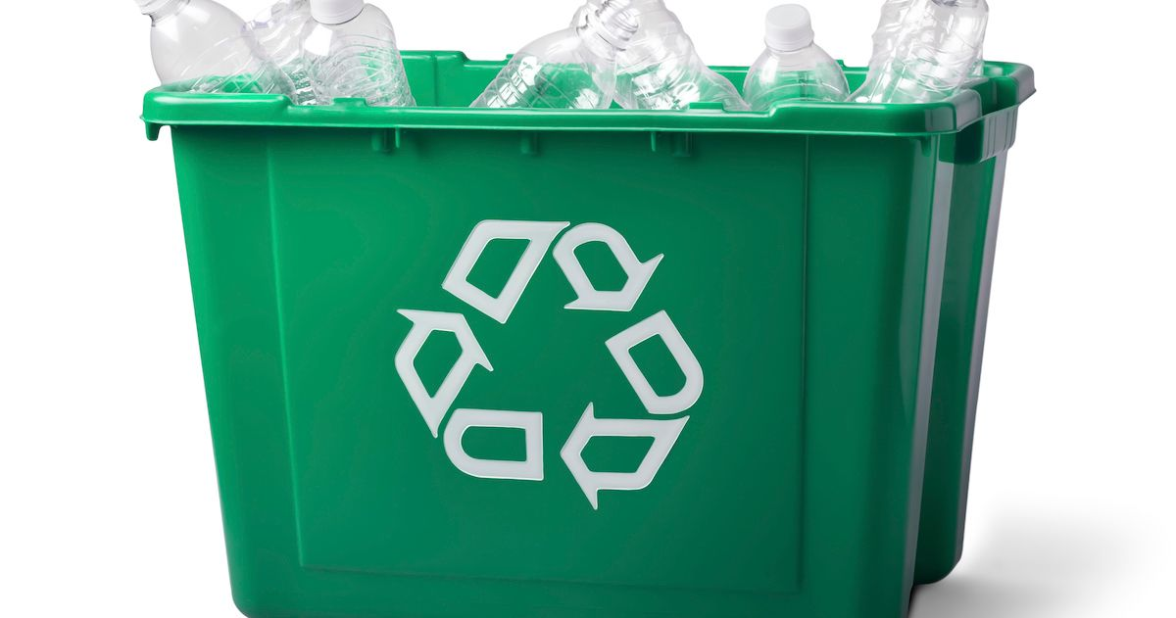
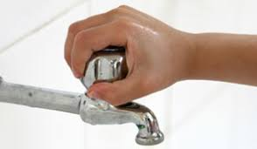


Time to reflect
What do we do at school to show respect to Gods world?
Notes:
Jacob W - In school we have lots of things that we do to show respect and help our environment.
Recycling bins
Turning off lights when we leave the room
Not dropping litter and putting it in the bins
Ben –
Walking to school if you can, to stop pollution
Turn off taps – so we do not keep water running
Not wasting paper
Having reusable water bottles

Slide 12
Once again, you may put you hands together, bow your heads or simply reflect quietly,
Let us pray.
Dear God,
respect
environment
promise
Amen

Slide 13
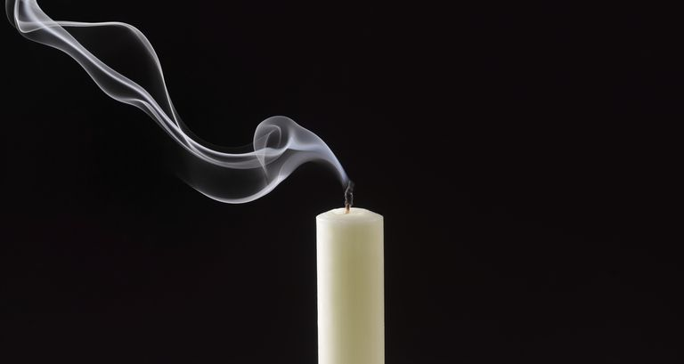
Join in should you wish:
Peace be with you.
And also with you.
Go in peace. Go in kindness. Go in love.

Slide 14
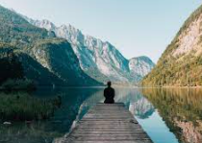
Minute of Mindfulness
A Breath of Fresh Air
https://www.youtube.com/watch?v=JrQMlzvsLIU
Notes:
Jay - God was pleased with what he had made. He had respect for the good work he had done. It is good for us, too, to respect ourselves and the work that we do.
Lily - Let's close our eyes now and think about respect - for ourselves, for the place where we live and for one another. Consider how we can show respect today.

Slide 15
WW
https://www.youtube.com/watch?v=idQ1n3cdgfo
Notes:
Jay –
Remember we should always be Wycliffe working through school at all times.
Ben –
We are now going to put one of my favourite hymns on for you to listen to as you leave the hall.

