Slide 1

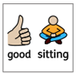
https://www.youtube.com/watch?v=1g4b_riGBL8

Slide 2


RESPECT

Slide 3






Our Vision
Vision Statement
“Life in all its fullness” (John 10:10)
Our vision is to ensure that our school family are happy and fulfilled in a creative learning environment. This is flexible and caters to individual needs while developing a life-long love for learning through which all members can flourish. We nurture an aspirational family of hard-working, respectful individuals who work collaboratively.
love for learning
flourish
nurture
respectful
creative
collaboratively
Notes:
I have covered a line from our school vision which will be the focus of our CW today.
Whilst I am reading the vision, I would like you to think about the missing line.

Slide 4
Our vision is to ensure that our school family are happy and fulfilled in a creative learning environment. This is flexible and caters to individual needs while developing a life-long love for learning through which all members can flourish. We nurture an aspirational family of hard-working,
respectful individuals who work collaboratively.
ALL DIFFERENT - ALL EQUAL
Notes:
We are going to look at aspects of respect from a different faith –
I am going to show you some clues, what faith do you think we will be focusing on?

Slide 5
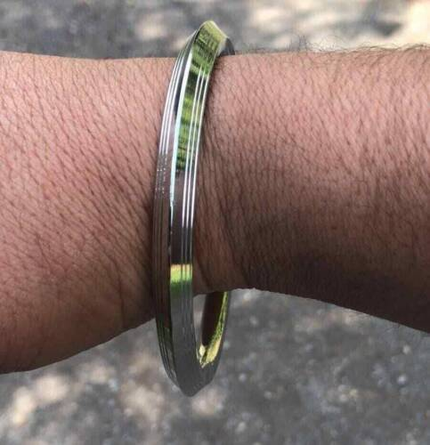
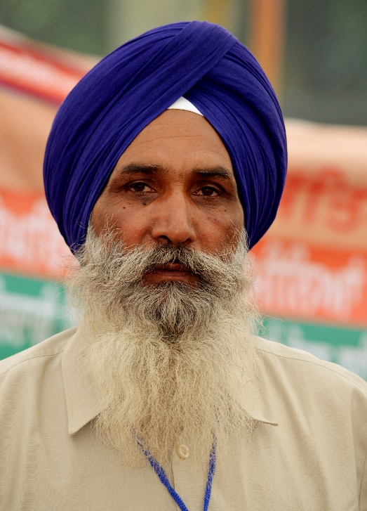

Notes:
Kara - It is a bracelet to show the connection to God. The bracelet is a circle and never-ending - no beginning or end - symbolising that God has no beginning or end.
Kesh – which means hair – people of this religion promise not to cut their hair
The symbol that represents this religion

Slide 6
A reminder that
all parts of our Service are invitational –
please simply be respectful
and
mindful of the
participation of others.

Slide 7
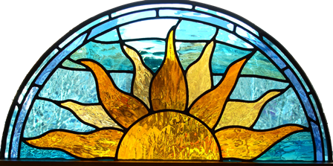
This is the day that the Lord has made.
Let us rejoice and be glad in it.

Slide 8
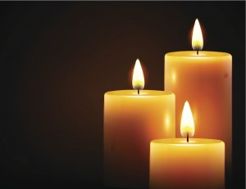
What do the three candles represent?

Slide 9
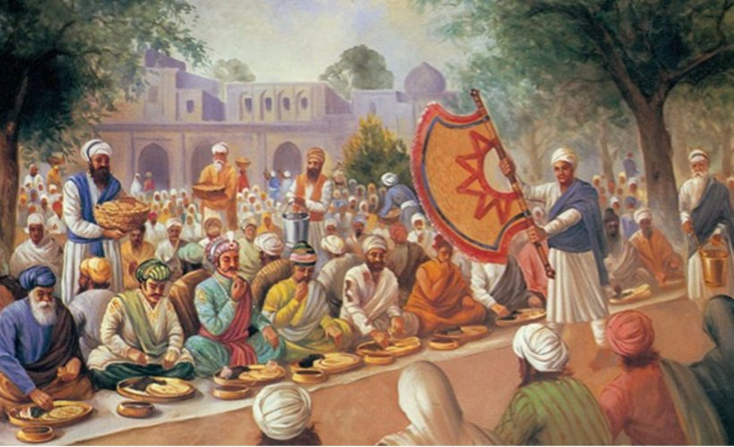
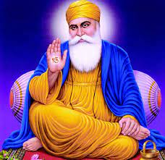
Notes:
Sikhism was founded by a wise man called Guru Nanak. Guru Nanak is considered the first Sikh Guru.
Guru Nanak understood the importance of helping others who had nothing.
He wanted to help people and felt that profit was not important. He started teaching others the same principle.
Guru Nanak began teaching the importance of the equality of all people, regardless of their caste, religion or gender. He taught that everyone is created by God’s will and therefore we must all be treated equally and with respect.
Guru Nanak established the langar. On his travels he invited all people to sit and eat with him. He offered free food to all.
Guru Nanak designed a way in which all people would sit on the floor together, as equals, to eat the same simple food.
It is here that all people, high or low, rich or poor, male or female all sit in a row or line to share and enjoy the food together.
Staff you are invited to also join in and sit on the floor with us as equals if you would like.
It is designed to uphold the principle of equality between all people of the world, regardless of religion, caste, colour, creed, age, gender or social status.
The langar expresses the ethics of sharing, community, inclusiveness and oneness of all humankind.
This shows the importance Guru Nanak placed on actions as well as teaching. Everyone is important and therefore everyone must be treated equally.

Slide 10
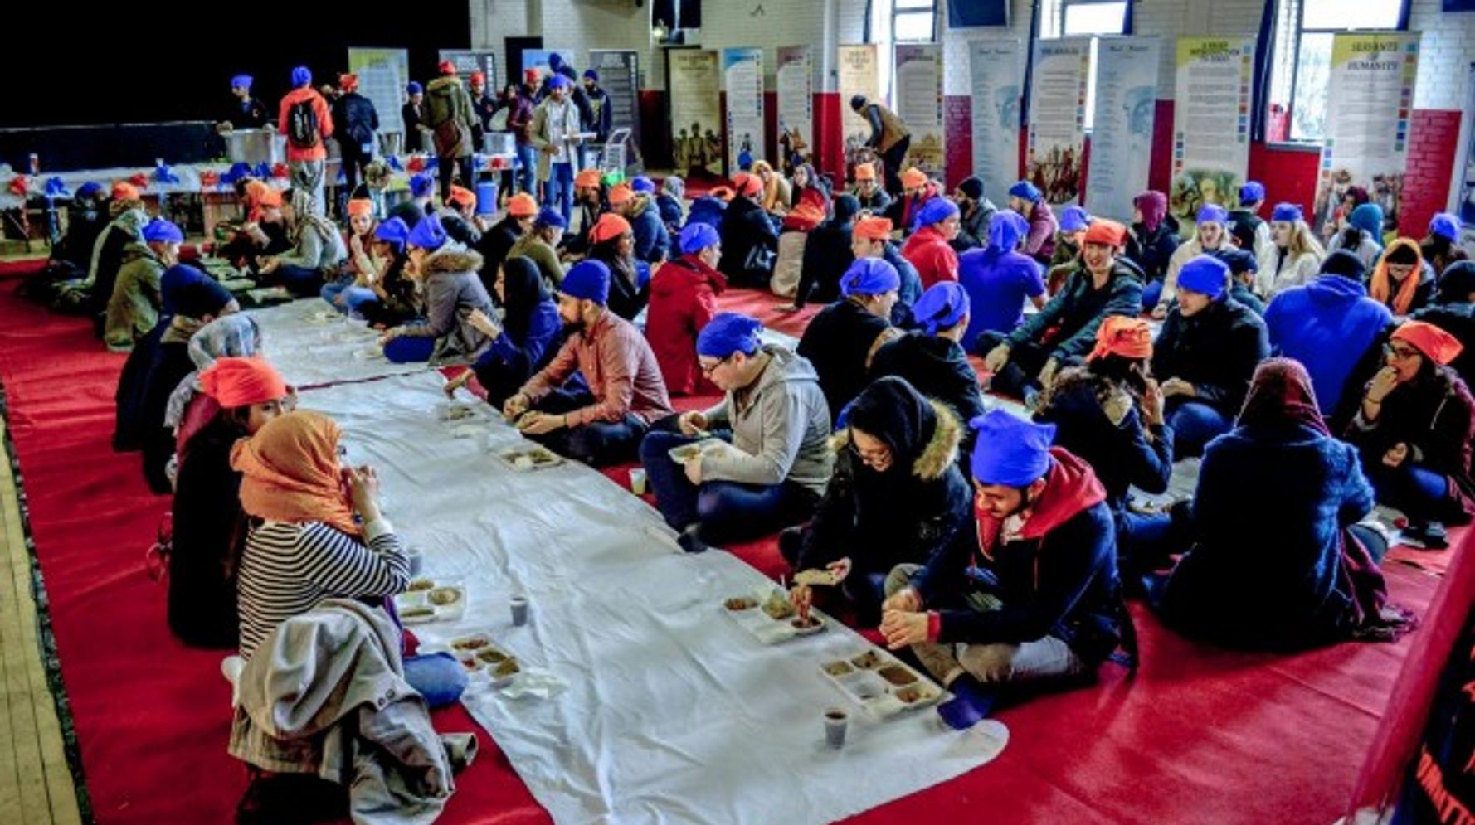
Notes:
Today, Sikhs follow this teaching. They welcome all beings into the gurdwara and offer food from the langar. They treat everyone with respect and dignity.
Everyone is welcome to the langar; no-one is turned away.
The food is usually served twice a day, every day of the year.
Each week, a family or several families volunteer to provide and prepare the langar. This is very generous, as there may be several hundred people to feed. All the preparation, cooking and washing-up is done by volunteers or voluntary helpers.

Slide 11
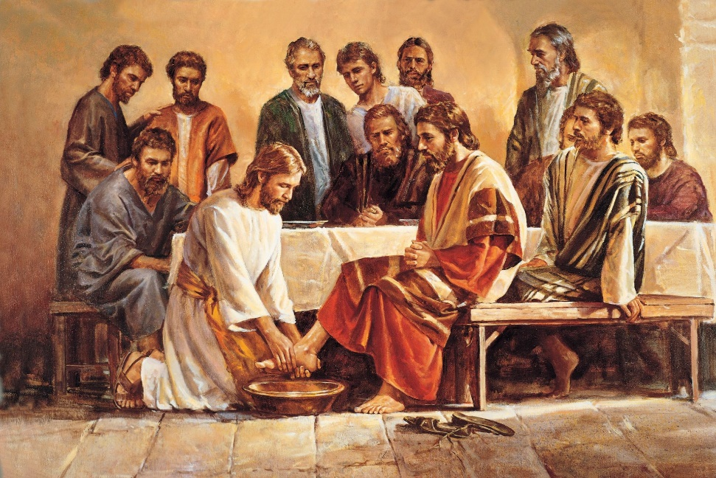
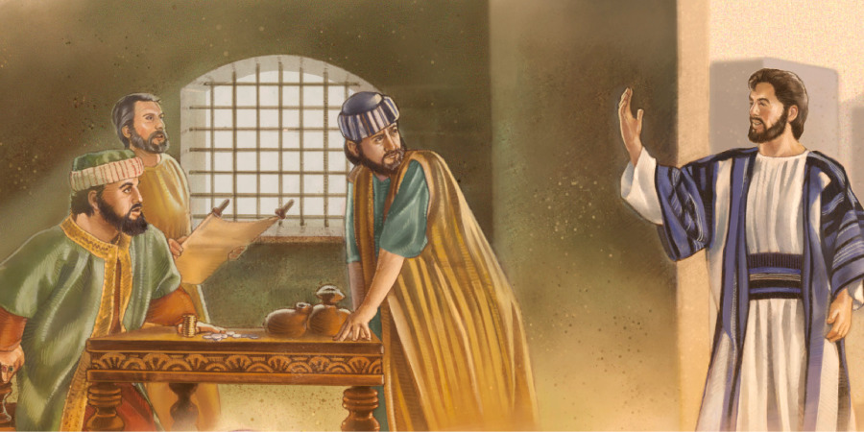
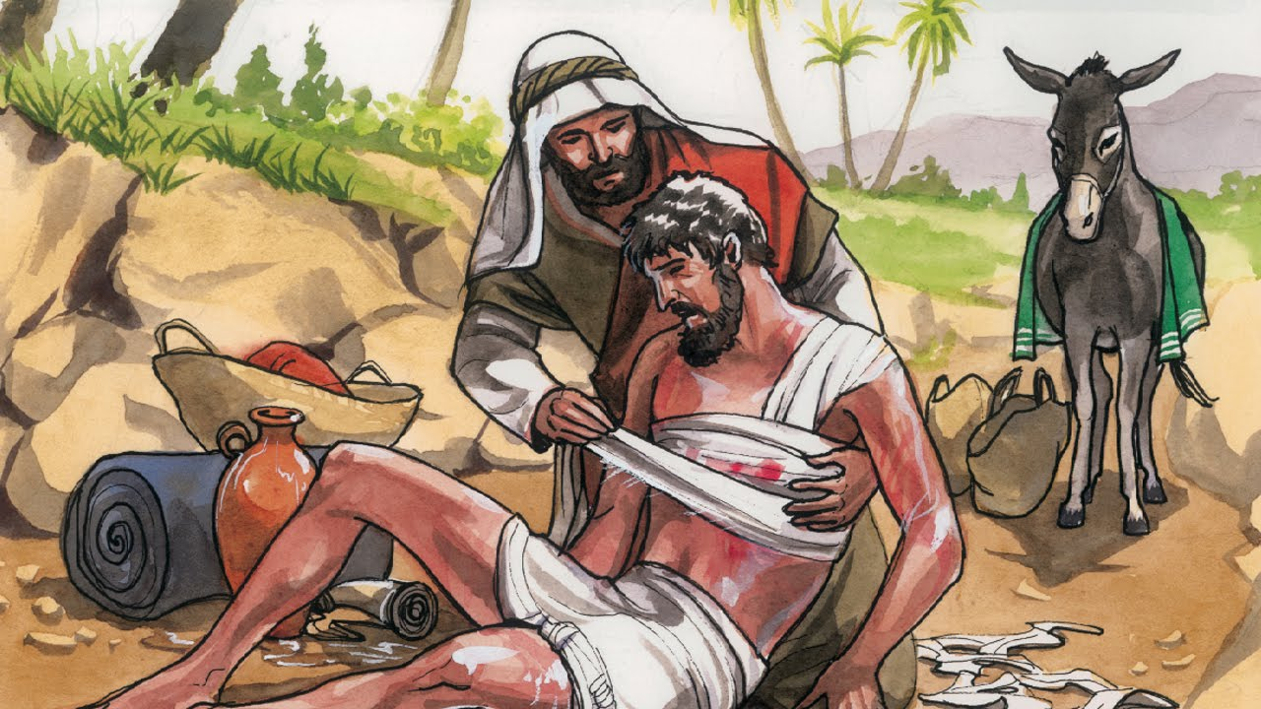
Notes:
The message of respect for everyone can be seen in lots of religions. We have heard bible stories with the same message.
Jesus washing his disciple's feed
When Jesus made friends with Matthew, even when Matthew was not liked by others
The story of the good Samaritan

Slide 12
respectful individuals who work collaboratively.
How will you show respect today?
Notes:
This could be as simple as holding a door open for somebody or listening to others.
Would anyone like to share?
What is our school moto? All different and all equal

Slide 13
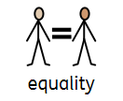
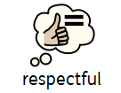
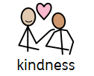
Once again, you may put you hands together, bow your heads or simply reflect quietly,
Let us pray.
Amen

Slide 14
This is the word of the Lord.
Thanks be to God.

Slide 15
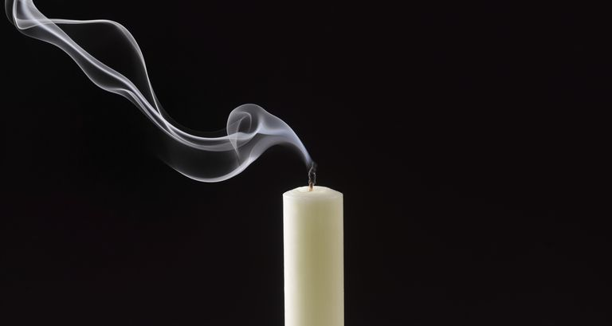
Join in should you wish:
Peace be with you.
And also with you.
Go in peace. Go in kindness. Go in love.

Slide 16
WW

