Slide 1
Spelling Revision Clubs
Thursday 01.02.2024

Slide 2
Past tense verbs
There are lots of different spelling rules for past tense but what do most regular past tense verbs end in…
ed

Slide 3
Phonics recap…
a-e
i-e
u-e
o-e
hoped
hopped

Slide 4
Phonics recap…
a-e
i-e
u-e
o-e
chopped
choped

Slide 5
Phonics recap…
a-e
i-e
u-e
o-e
diped
dipped

Slide 7
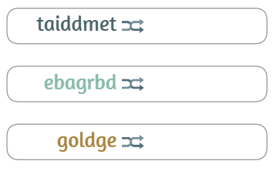

Slide 9
Choose a common exception word that you know you find tricky.
Write it lots of different ways.
Use colours.
Draw boxes around each letter.

