Slide 1
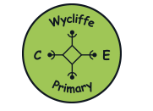
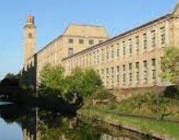
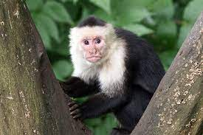
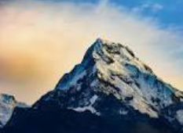
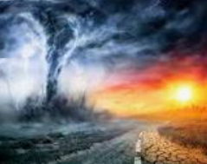
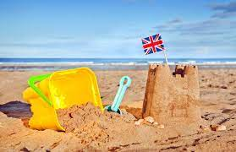
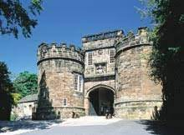
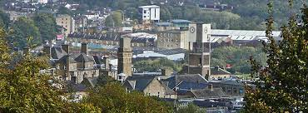
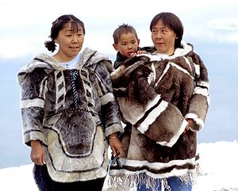
Wycliffe’s Geography Learning Journey
Year 6- Rainforests and deforestation
What impact has
Salts Mill had on
our local area?
YEAR
6
What’s the matter
with Capuchin?
Would you like to live in a
place like this and why?
YEAR
5
Which is the
deadliest mountain-
Mount Everest or Ben Nevis?
Year 3 – Natural disasters, Physical Geography including land use, natural resources and sustainability
Year 4 – Mountains
YEAR
4
Is there enough
for everyone?
What makes the Earth
angry?
YEAR
Year 2 –Comparing UK seasides with Jamaica
3
Why do we like to be
beside the seaside?
YEAR
Year 1- Geography of local area, weather patterns and a comparison of Shipley with Tanzania.
2
Can you keep a
monkey as a pet in Shipley?
Why live in
a place like this?
YEAR
1
UNDERSTANDING THE WORLD
EYFS
CAN A POLAR BEAR
AND A PENGUIN BE
FRIENDS?
Reception

