Slide 1
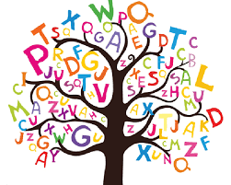
Spelling Workshop
Tuesday 8th October 2024

Slide 2
Why is spelling so important?
“Spell-check, as most of us know, sometimes corrects spelling to a different word than intended. If the writing is not later proofread, this computer-created error goes unnoticed.’’
*Spell check and homophones = lacks professionalism*
Develops reading skills and improves vocabulary: knowing how to spell correctly makes children better readers as they’re more likely to be able understand a word’s true meaning and recognise unfamiliar words better. Word families/root words e.g. creation, creative, creator etc.
It enhances writing as it is like learning to ride a bike. Once you’ve got it, you can concentrate on other areas of your writing.
Confident speller = improved levels of concentration in all curriculum areas.

Slide 3
National Spelling Expectations
Year 1
See packs

Slide 4
National Spelling Expectations
Year 2

Slide 5
National Spelling Expectations
Year 3/4/5
+Y4
+Y5
Year 6

Slide 6
What we do in school to develop spelling skills…
Weekly spelling tests
Weekly spelling lessons to teach the spelling rules given for spellings
Provide a Spelling Frame login
Weekly spelling warm-ups
Spelling mats- common exception words/phonics available in classrooms.

Slide 7
We need your help!
Children need to have regular, short bursts of spelling practice to achieve this. Daily consolidation, just for 5 minutes is far more effective than trying to learn them in one go, once a week. This will just create week connections that quickly fade.
First the memory must be created. Your child’s brain send signals in a particular pattern associated with the word they are looking at and begins to create connections between neurons, called synapses. This will begin to happen in school when the spelling is taught. If they don’t do anything further, that connection disappears and the memory disappears with it. Consolidation is the process of committing it to the long-term memory so we can recall it later. The more your child practises each spelling, the stronger the connections in the brain become. This requires lots and lots of practice of each spelling! Then your child needs to be able to recall the memory. Each time they remember how to spell a word, the brain uses the connections they have build, making them even stronger.

Slide 8
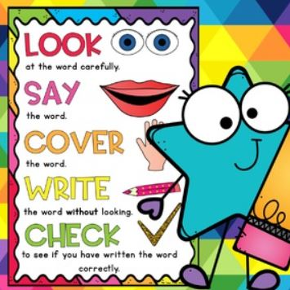

Slide 15
Use the spelling words from previous weeks – type them- muscle memory
Mnemonics
e.g. necessary/because
Make spellings visible
Say words in a silly way e.g. friend = fri – end, car-pet
Games and puzzles: wordsearches, hangman

Slide 16
Login details are in your child’s reading record
https://assets.publishing.service.gov.uk/media/5a7ccc06ed915d63cc65ce61/English_Appendix_1_-_Spelling.pdf

