Slide 1
Year 6 Residential to RobinWood 2025
Don’t forget to order Y6 hoodies. The closing date is 18th November.

Slide 2
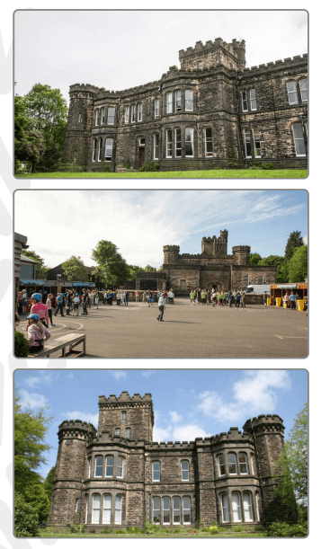

Slide 3
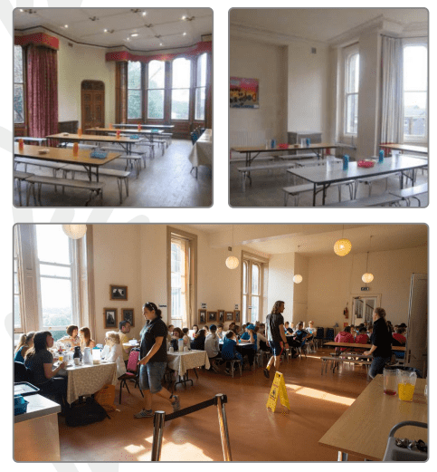
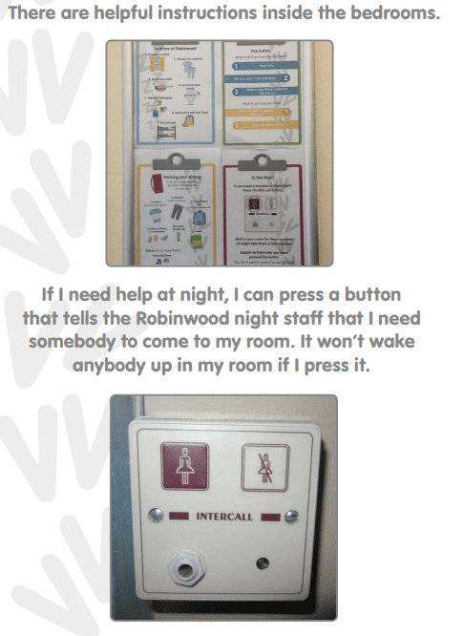
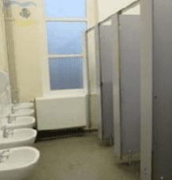
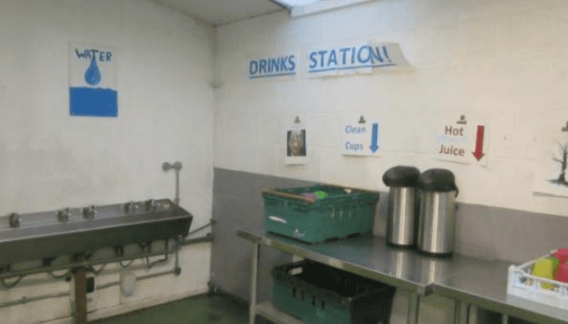

Slide 4
Wednesday 8th – 10th January
Staff (3 groups): Mr Brigstock, Mrs Baxter and Mrs Ambler
9am leaving – arrives at Coach Park – walk to Robinwood
3:15 pm arriving back

Slide 5
DO NOT wear jewellery and please make sure long hair is tied up at all times.
Children must be able to tie their hair up themselves.

Slide 6
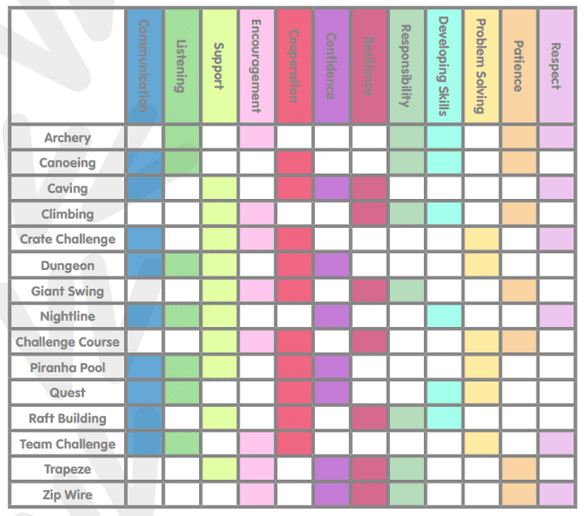

Slide 7
Example timetable.
Mix of indoor and outdoor activities so not too cold.
Showers are built into the timetable.
Each group has own timetable.
Team challenges at night.

Slide 8
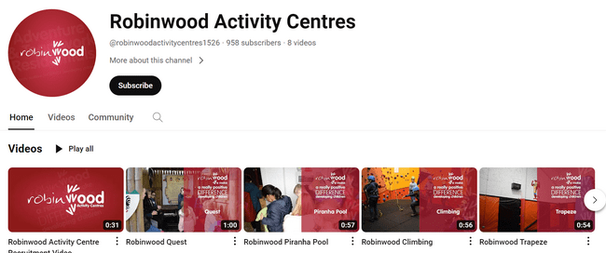
https://www.youtube.com/channel/UCjKd_v6mSxmP6DNc4uad6gQ

Slide 9
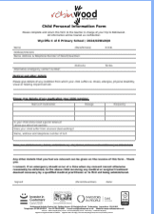

Slide 10
Luggage
ONE rucksack or suitcase- NO extra small bag – these get lost.
No water bottle is needed or snacks
Don’t worry- children do not carry this to Robinwood- it gets transported in a minibus.
A luggage tag will be provided but PLEASE label your bag also include name and school name.

Slide 11
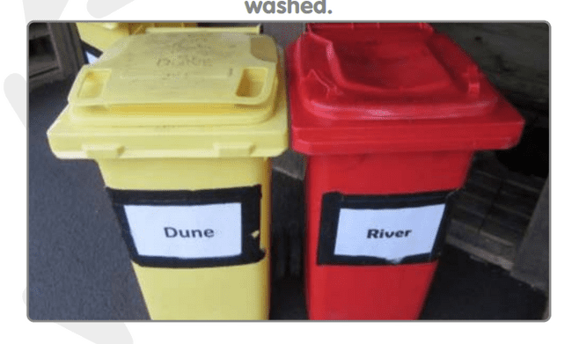
ALL clothing must be named. Do not bring best clothing, it may get lost or damaged in the activities.

Slide 12
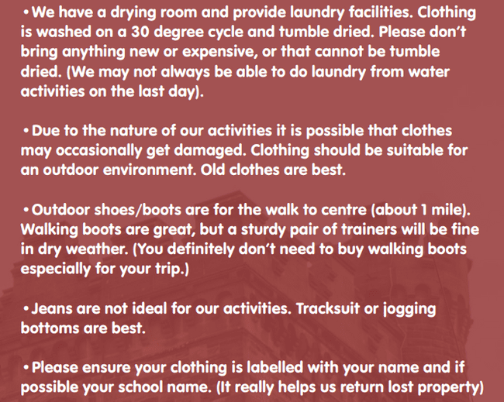

Slide 14
Groups and rooms:
Children will find these out when we arrive at Robinwood
Trust us ☺
For in your room, you may bring one small teddy or a book- again, please make sure it is named.

Slide 15
Any questions?

