Slide 1
High Adventure Year 5
September 2025

Slide 2
High Adventure
High Adventure is in Cowling. It is an outdoor residential centre that has been open since 2001.
Activities are led by trained staff and they have 1st aid training.
All activities are onsite for this trip.

Slide 3
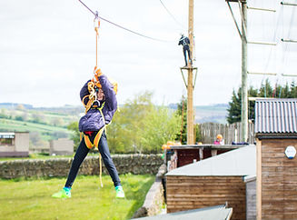
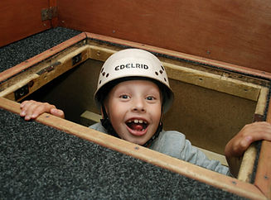
Schedule 15.09.25
11:00 Leave Wycliffe
12:00 Arrive High Adventure. Welcome Meeting and Lunch
13:30 Activity – Zip Wire / Crate Stack
17:30 Evening Meal
18:30 Activity – Campfire and circus / Archery
20:30 Downtime before lights out: evening class books by staff/charades etc

Slide 4
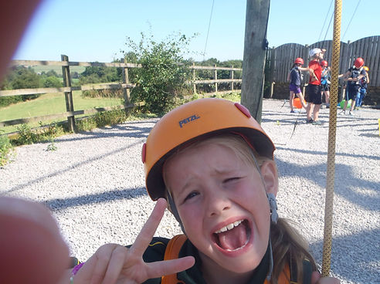
Schedule 16.09.25
7:30 Wake up
8:00 Breakfast then sandwich making (ingredients provided)
8:45 Morning meeting
9:30 Activity – Team building/ Bushcraft/ Bouldering
12:00 Lunch
12:30 Goodbyes and collect belongings
13:00 Leave High Adventure
13:40 Arrive at Wycliffe

Slide 5
Staffing
Mr Holdsworth or Mrs Baxter (Both days and overnight)
Miss Greaves (Both days and overnight)
Other staff to be confirmed.

Slide 6
Transport
Children will travel to High Adventure on 3 minibuses. Staff will be on each bus.
Due to the size of the minibus, children’s bags must fit on their lap.
If your bag is too big we will put your items in a carrier bag instead.

Slide 7
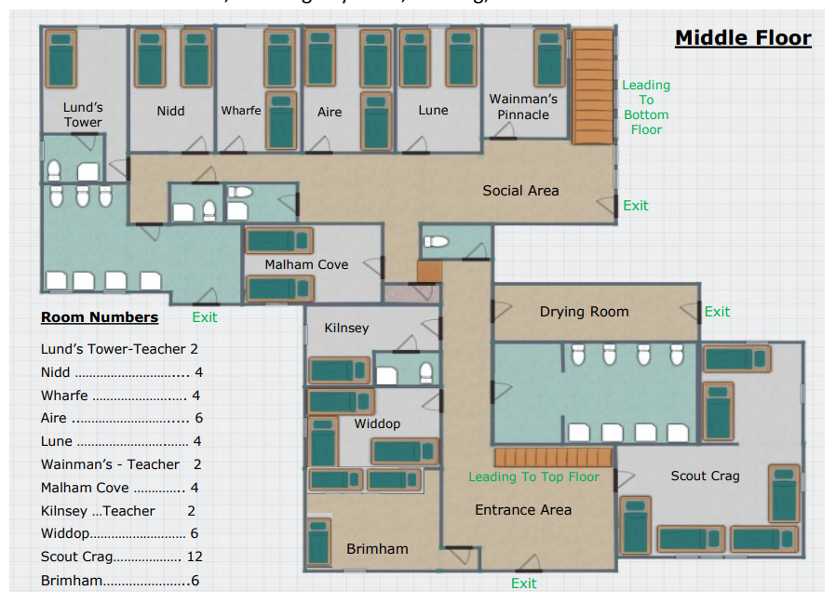
Sleep arrangements
Rooms have 4-12 beds in them (bunkbeds).
Children will be asked for 3 children they would like to share with. We will aim to put them with at least one.
Boys and girls will be grouped together to share a toilet / shower room. Teachers’ rooms are on the same floor.
Clean bedding is provided and children will make their own beds when they arrive.

Slide 8
Toilets
Boys and girls will have their own toilet / shower rooms.
These have cubicles.
Children will have the option of having a shower if they wish.

Slide 9
Food
On the first day, children will need to bring a packed lunch. This needs to be in a named disposable bag. Children who receive free school meals can request one from the school kitchen.
The evening meal is to be confirmed.
On Friday, breakfast is beans, eggs, hash browns, toast, cereal and fruit juice or water.
For lunch on day two, children will make their own packed lunch, ingredients are provided.
Dietary requirements have been sent to High Adventure and alternatives will be available.

Slide 10
Medication
School will take medications / inhalers that are normally administered during school hours.
If your child has medication that needs to be taken outside these hours, please see Mr. Hussain in the office.

Slide 11
Kit Please arrive in suitable bottoms, t-shirt, jumper and trainers. Warm coat / fleece. No jeans. Name everything and pack with your child.
All kit should fit into a small rucksack/bag that your child can carry by themselves.
The bag should include:
A t-shirt
A jumper (not a hoody)
One pair of bottoms, for example (joggers, tracksuit bottoms, leggings, shorts) no jeans
A pair of pyjamas and slippers / sandals
A pair of socks and underwear
A toothbrush and toothpaste
A towel, shower gel and deodorant
Water bottle (must be transparent)
Small Teddy
High Adventure will provide waterproofs if required
No mobile phones, gadgets, books or games are needed.

Slide 12
Questions
Total cost will be confirmed.
If you have a question, please speak to a member of staff at school or send an email to the office.

