Slide 1

Key stage 2 SATS 2026
Parent Meeting 17.11.2025
Don’t forget to order Y6 hoodies. The closing date is 18th November.

Slide 2

What are the SATs?
● SATs are the Standardised Assessment Tests that are given to children at the end of Key Stage 2.
● The aim of the tests is to establish whether pupils are working at an expected level in English and Maths for the end of primary school and the start of secondary school.
● The SATs take place over four days, starting on Monday 11th May ending on Thursday 14th May.
● English writing judgements are made by the pupils’ teachers through teacher
assessment, based on evidence of independent writing gathered over the course
of year 6.

Slide 3
Why are SATs important
for your child?
They give child a sense of achievement after their 7 years in Primary School.
They will determine the groups your child will be set into in secondary school.

Slide 4
SATs is just one part of Y6
Mocks at stages throughout the year will imitate SATs so it does not seem different.
Lots to look forward to, celebrate and embrace about Y6.
Embrace SATs- show off what you know!

Slide 5
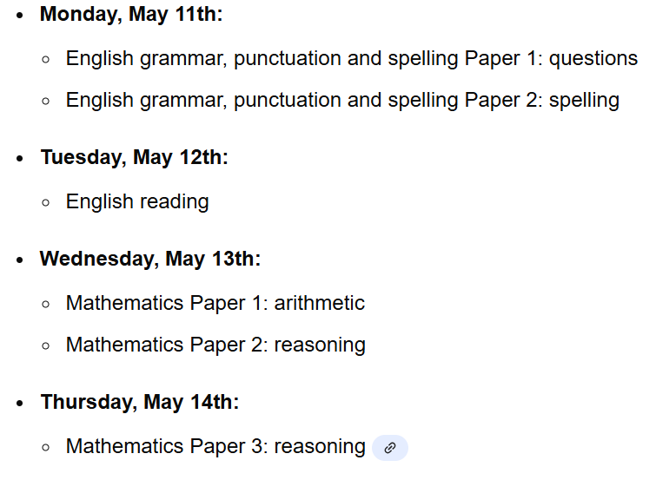
Key stage 2 The key stage 2 tests are timetabled from Monday 11th May- Thursday 14th May

Slide 6
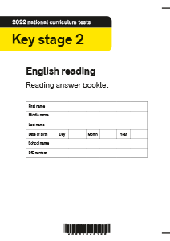
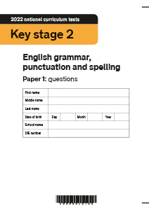
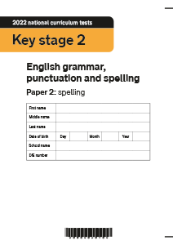
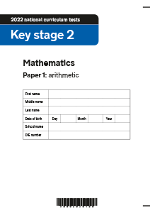



Slide 7
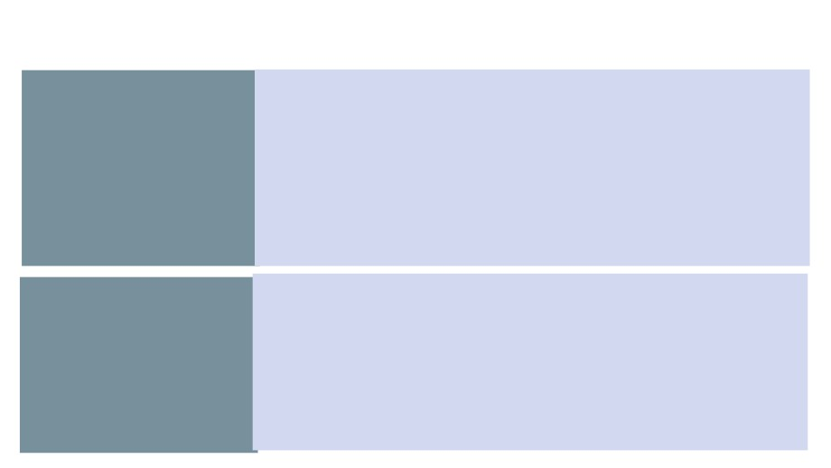
What are the children tested on?
Paper 1: questions (45 minutes) 50 marks
English
A combined question and answer booklet which assesses pupils’ understanding of the grammar, punctuation and spelling elements of
Grammar, Punctuation
the national curriculum English programmes of study for key stage two.
Paper 2: spelling (15 minutes but not strictly timed) 20 marks
The paper that pupils receive has 20 sentences, each with a missing
and Spelling word. The teacher reads the sentences one at a time and pupils write in
the missing word on their paper.
(1 hour) 50 marks
English
Pupils will have a reading booklet with three different texts to read and a corresponding question and answer booklet. The texts are presented in increasing levels of difficulty and pupils’ comprehension skills will be assessed against the comprehension elements of the English programme of study for key stage two.
Reading

Slide 8

Paper 1: arithmetic (30 minutes) 40 marks
Pupils will have a booklet of arithmetic questions based on the
national curriculum maths key stage two programmes of study.
Mathematics
Papers 2 and 3: reasoning (40 minutes each) 35 marks each
Both papers will ask children to reason and solve problems, again
based on the national curriculum maths programmes of study.

Slide 9
Spelling, Punctuation and Grammar: Paper 1
The children will have been working hard with their class teacher on developing and securing their knowledge of the technical vocabulary needed in this test.
This test focuses on:
● Grammatical terms/ word classes; ● Functions of sentences;
● Combining words, phrases and clauses; ● Verb forms, tenses and consistency; ● Punctuation;
● Vocabulary;
● Standard English and formality.
This test requires a range of answer types but does not require longer formal answers.

Slide 10
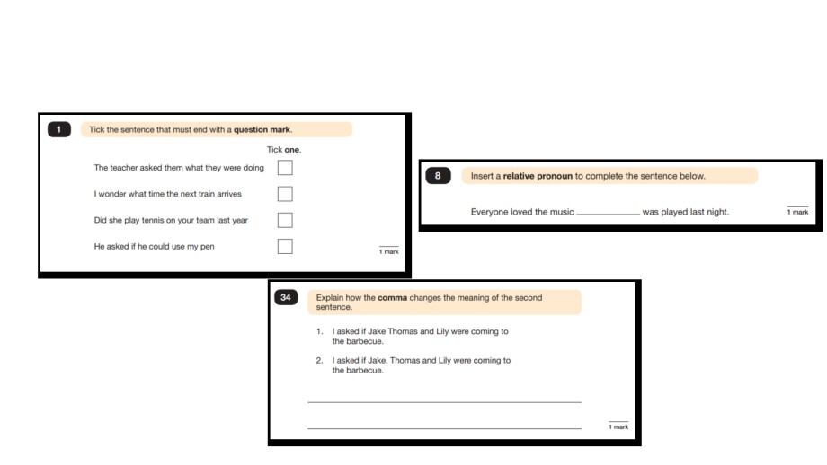
Spelling, Punctuation and Grammar: Paper 1
Example questions:
e.g. that, which
✓
e.g. The first sentence is about two people and
the second sentence is about three people.

Slide 11
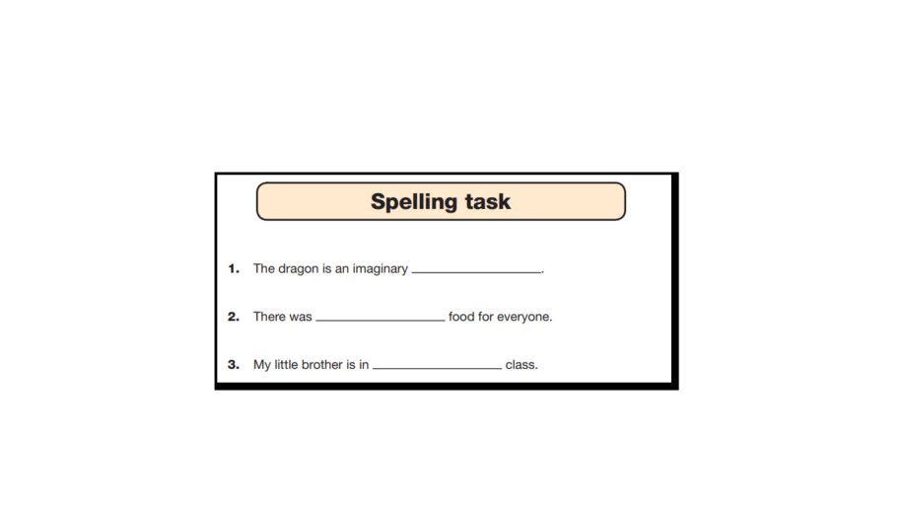
Spelling, Punctuation and Grammar: Paper 2
Paper 2 is a shorter paper that focuses solely on spellings.
Example questions:

Slide 12
You can support at home by: - Recapping spelling rules - Revisiting Y3, 4 ,5 and 6 common exception words -Encouraging writing in real life to include correct grammatical features- capital letters, full stops and apostrophes are most common errors- and spellings e.g. To Mrs brodrick, I hope your having a good time teaching us. Have a great christmas! From jane
These are Y2 objectives!! Written answers in the test will be marked wrong with these mistakes.

Slide 13
Reading
There is one reading test that lasts for 60 minutes.
The test is designed to measure whether the children’s comprehension of age-appropriate reading material meets the national standard. There are three different set texts for children to read. These could be any combination of non-fiction, fiction and/ or poetry.
The test covers the following areas (known as Content Domains):
● Give/ explain the meaning of words in context;
● Retrieve and record information/ identify key details from fiction and non-fiction; ● Summarise main ideas from more than one paragraph;
● Make inferences from the text/ explain and justify inferences with evidence from the text; ● Predict what might happen from details stated and implied;
● Identify/ explain how information/ narrative content is related and contributes to meaning as a whole;
● Identify/ explain how meaning is enhanced through choice of words and phrases; ● Make comparisons within the text.

Slide 14
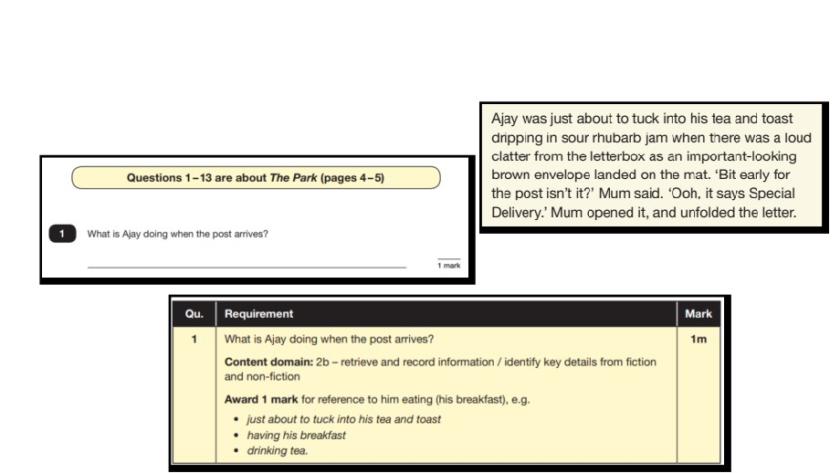
Reading
The reading SATs paper requires a range of answer styles.
Example questions:
No need for full sentences in some questions.

Slide 15
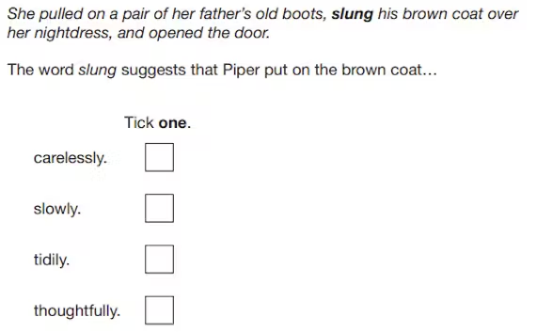
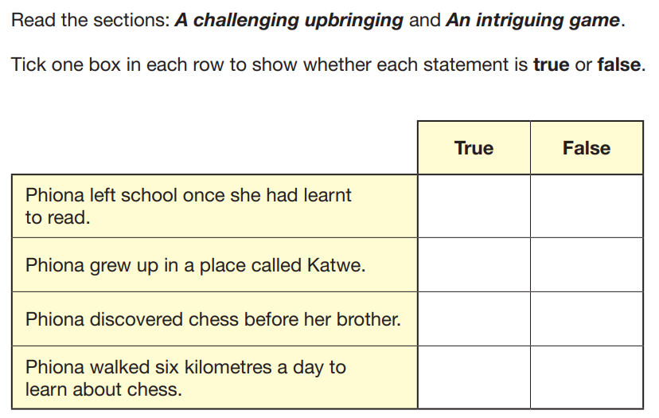
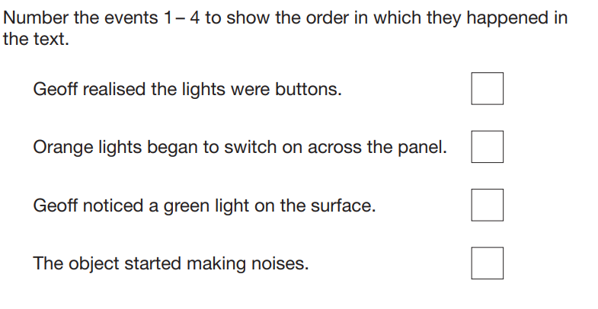

Slide 16
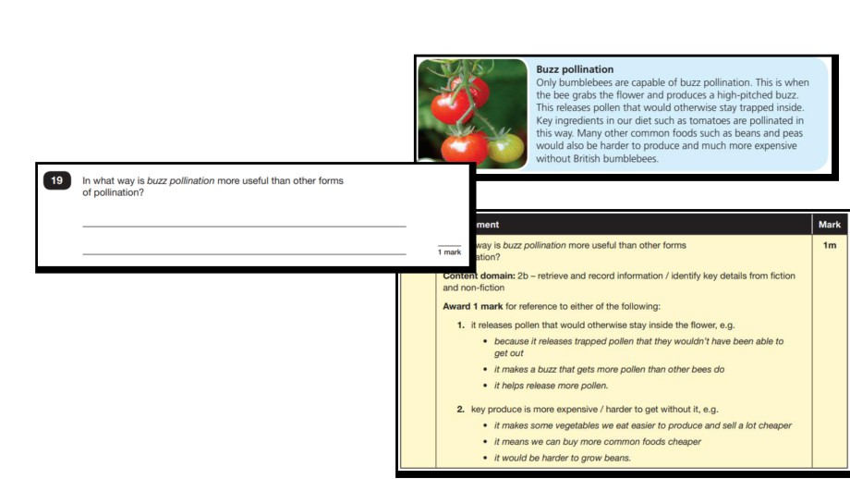
Reading
Example questions:
Based on text 2: Fact Sheet: About Bumblebees

Slide 17
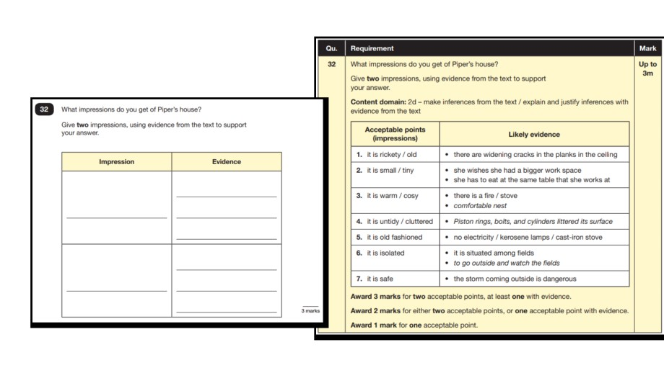
Reading
Example questions:
Based on text 3: Music Box

Slide 18
Reading
Since the current testing formation for the SATs began in 2016, there has been a
tendency for three types of questions to be the most popular.
On average:
● 12% of marks could be gained from answering questions involving giving and
explaining the meaning of words in context;
● 42% of marks could be gained from answering questions involving retrieving and
recording information or identifying key details from a text;
● 36% of marks could be gained from answering questions involving making inferences
from a text and justifying inferences with text evidence.
When reading with your child at home try focusing on these types of questions.

Slide 19
You can support at home by: - Accelerated reader - Explore meaning of words. Tell me another word that means the same as… - School reading book – read with your child- ask them if they know the meaning of words. -Ask questions about books of interest -Comprehension with films/programmes- inference- evidence

Slide 20
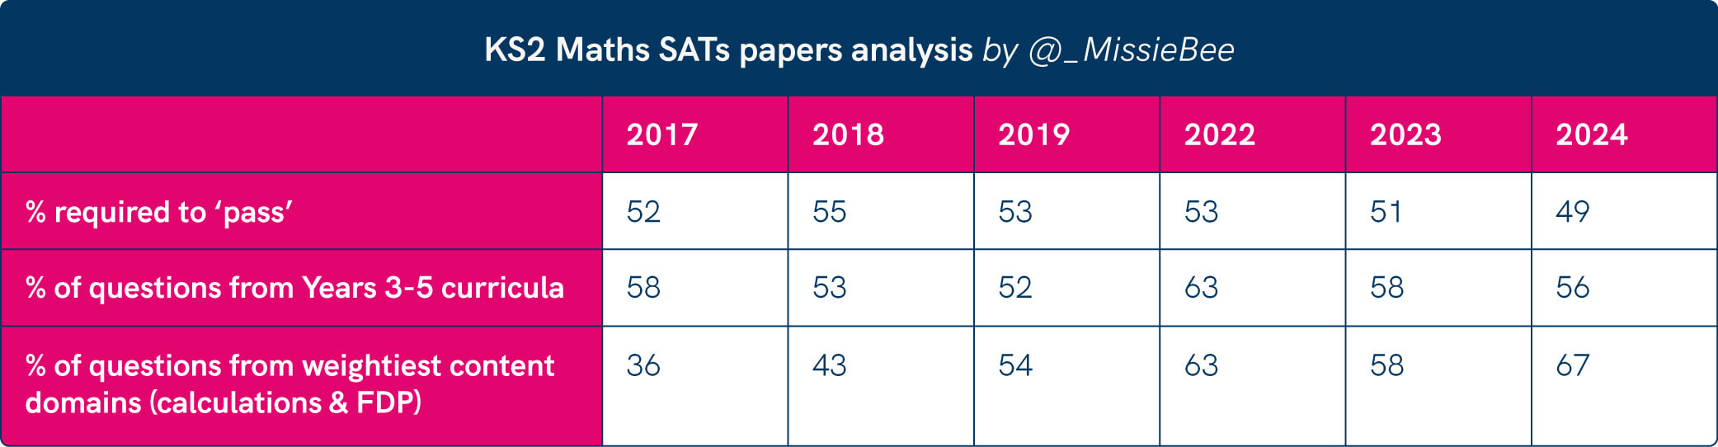

Slide 21
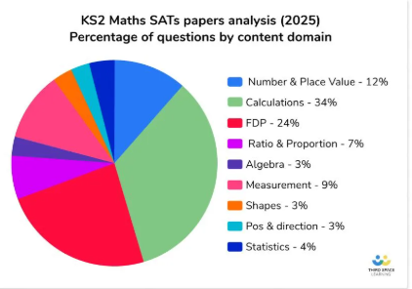











Very important elements

Slide 22
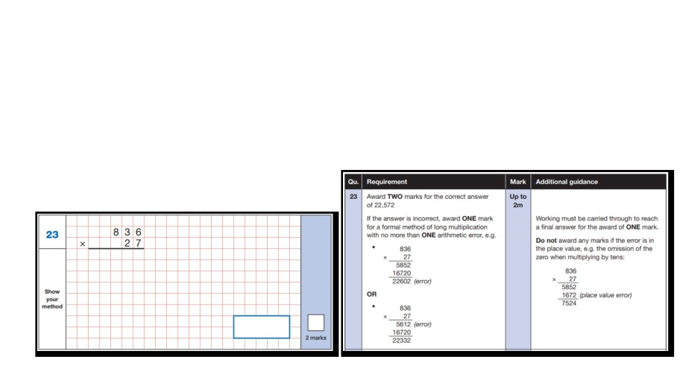
Maths Paper 1 (Arithmetic)
The maths arithmetic paper has a total of 40 marks.
The test covers the four operations (addition, subtraction, multiplication, division, including order of operations requiring BIDMAS), percentages of amounts and calculating with decimals and fractions.
Example question:

Slide 23
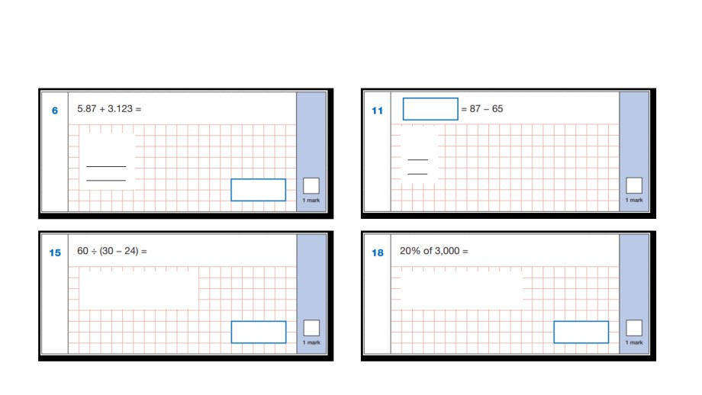
Maths Paper 1 (Arithmetic)
Example questions:
22
5.87
87
+ 3.123
- 65
8.993
22
8.993
60 ÷ (30 - 24)
10% of 3,000 = 300 20% of 3,000 = 600
60 ÷ 6 = 10
10
600

Slide 24
Maths Papers 2 and 3 (Reasoning)
These papers require children to demonstrate their mathematical knowledge and skills, as well as their ability to solve problems and their mathematical reasoning. They cover a wide range of mathematical topics from key stage 2 including,
● Number and place value (including Roman numerals); ● The four operations;
● Geometry (properties of shape, position and direction); ● Statistics;
● Measurement (length, perimeter, mass, volume, time, money); ● Algebra;
● Ratio and proportion;
● Fractions, decimals and percentages.

Slide 25
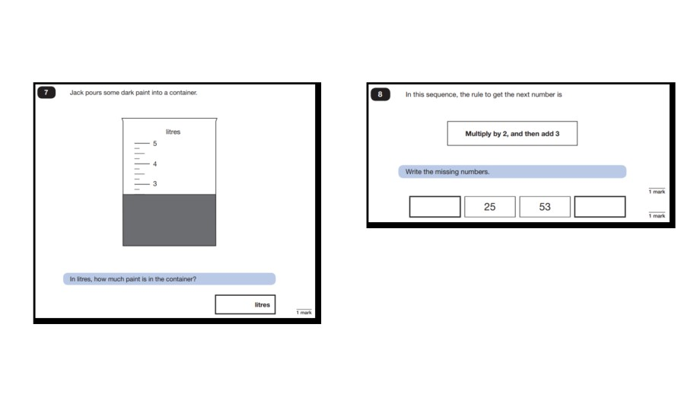
Maths Papers 2 (Reasoning)
Example questions:
11
109
2.5 or 2 ½

Slide 26
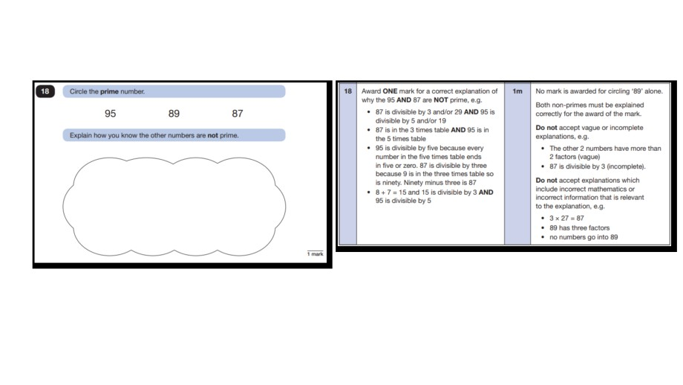
Maths Papers 2 (Reasoning)
Example question:

Slide 27
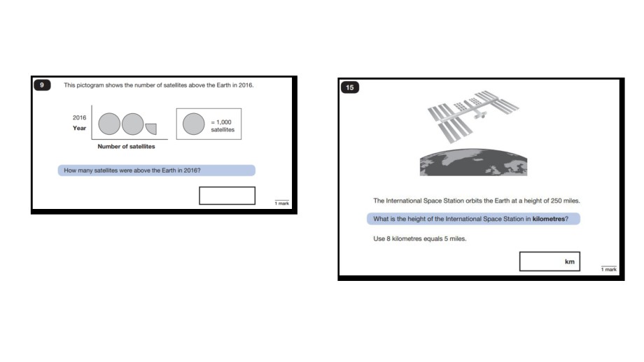
Maths Papers 3 (Reasoning)
Example questions:
2,250
400

Slide 28
You can support at home by: - TTRS - Learn by hearts -Real life situations that involve maths- baking, measuring, time, shape, discounts - Revision guides
Don’t do past papers at home!

Slide 29
Approximate Timetable
Paper | Approximate Start Time | Timing | Approximate End Time
English grammar, punctuation and spelling paper 1 | 9.20am | 45 minutes Extra: 57 minutes 30 seconds | 10.05am 10.30am
English grammar, punctuation and spelling paper 2 | 11am | Approx 15 minutes | 11.15am
English reading | 9.20am | 60 minutes Extra: 75 minutes | 10.20am 10.35am
Mathematics Paper 1: arithmetic | 9.20am | 30 minutes Extra: 37 minutes 30 seconds | 9.50am 10.00am
Mathematics Paper 2: reasoning | 11.00am | 40 minutes Extra: 50 minutes | 11.40am 11.50am
Mathematics Paper 3: reasoning | 9.20am | 40 minutes Extra: 50 minutes | 10.00am 10.15am

Slide 30
When and how the SATs are completed?
● The tests take place during normal school hours, under exam conditions.
● The tests will be taken in the classrooms, supported by adults who know them.
● Children are not allowed to talk to each other from the moment the
assessments are handed out until they are collected at the end of the test.
● After the tests are completed, the papers are sent away to be marked externally.

Slide 31
After each test
Some light revision, with unrelated activities in the afternoons.

Slide 32
Results
Tests are marked externally. Once marked, the tests will be given the following scores: ● A raw score (total number of marks achieved for each paper); ● A scaled score (see below);
● A judgement on if the National Standard has been met.
After marking each test, the external marker will convert the raw score to a scaled score. Even though the tests are made to the same standard each year, the questions must be
different. This means the difficulty of the tests may vary. Scaled scores ensures an
accurate comparison of performance over time.
Scaled scores range from 80 to 120.
A scaled score of 100 or more shows the pupil is meeting the National Standard.

Slide 33
Results
These will be available at the end of the academic year.
Results will be shared with families on your child’s end of year school report.
Some papers may be sent back for remarking if it is felt they have errors that would change the scaled score.
This will not be known until 25-26 Academic Year

Slide 34
Revision groups
Lunchtime sessions and revision guides – please sign up – letter before you go.
Extra weekly Maths, Reading and Spelling groups in afternoons
Maths groups tailored to needs
Flexible groupings and interventions based on practice SATS tests

Slide 35

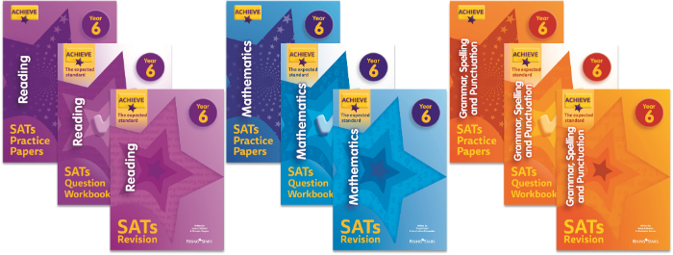
During the week of SATs, all children are invited to come in for breakfast and morning revision ‘top tips’. We will confirm the times for this before SATs begin.
Don’t leave revision to the last minute!

Slide 36

Spelling Frame, Accelerated Reader and TTRS
Useful websites
https://www.bbc.co.uk/bitesize/articles/zkyhb7h#zv6qp9q
English
GPS revision: https://www.bbc.co.uk/bitesize/topics/zhrrd2p
Spelling games: https://www.topmarks.co.uk/search.aspx?q=spelling Revision and practice questions: https://uk.ixl.com/english/year-6 Spelling rules: http://www.keystage2literacy.co.uk/spellings-menu.html Word list (NC spelling appendix):
https://assets.publishing.service.gov.uk/government/uploads/system/uploads/attachment_data/file/23978 4/English_Appendix_1_-_Spelling.pdf
Maths
Whole scheme of learning (videos, questions, assessments):
https://whiterosemaths.com/resources?year=year-6
Arithmetic practice and test examples: https://myminimaths.co.uk/ Quizzes: https://www.educationquizzes.com/ks2/maths/ Revision and practice questions: https://uk.ixl.com/maths/year-6

Slide 37


